Slide 1

Real Estate Investor Analysis
Notes:
Hello Everyone,
My name is Ron Cox and my dashboard capstone project is a Real Estate Investor Analysis.
I would greatly appreciate it…if you could hold all questions until the end of the presentation.

Slide 2

About Me
Experience
Retired Army Signal Officer
Former Microsoft ITSM Consultant
Education
MSCS , Colorado Technical University
BA Sociology, University of New Mexico
Korean Linguist, Defense Language Institute
Certifications
ITIL v3 Expert
Certified Knowledge Manager
Notes:
Here’s a little background on me…
I served 23 years in the Army, initially as an enlisted counterintelligence agent where I learned to speak the Korean language at the Defense Language Institute. I then transitioned to the Signal Corps as an officer after attending the Officer Candidate School at Fort Benning, GA.
Signal Officers have a multitude of responsibilities—basically anything with electricity flowing through it can fall within your sphere of responsibility. But I was lucky enough to have specialized in Information Technology during most of my career with plenty of training and certification opportunities while performing jobs ranging from lower-level Help Desk technician all the way to Deputy Director of the Joint Network Operations Control Center—Afghanistan where my team was responsible for the Army network throughout Afghanistan.

Slide 3

Hypothesis
When the housing market shifts from a seller’s market to a buyer’s market, there is a higher probability that sellers will drop their prices the longer the homes are on the market, particularly if their home is older and/or has distinct negative attributes such as swimming pools or mandatory HOA fees.
Notes:
As real estate investor, I’m always looking for my next potential rental property…
I hypothesize that certain home sellers, especially home builders, will provide the best deals in terms of price as days on market increases, especially if the home has negative attributes that investors want to avoid like HOA fees, high maintenance cost, and swimming pools which might increase my rental property insurance rates.

Slide 4

Data Science Framework
Obtain
Scrub
Explore
Model
Interpret
Notes:
I usually perform better with a good outline and some basic structure; therefore, I decided to utilize the OSEMI framework for Data Science Projects instead of the Microsoft Team Data Science Process Lifecycle that was presented the first week of class because the latter approach seemed more applicable to Machine Learning Projects that we’ll cover in later weeks whereas the OSEMI framework can be applied to a wide variety of data science projects.
And, having worked at Microsoft, I know they like to take the standard methodology and customize the guidance to correspond to their IT service offerings.

Slide 5
Obtain
That dataset was provided by my project partner, Lauren Anderson, who is a real estate agent with access to the Multiple Listing Service (MLS).
She ran a query of the listings from MLS.
The dataset initially contained 4,976 rows and 31 columns.
Notes:
Step 1 in the framework, Obtain the raw data:
My project teammate, Lauren, exported a dataset of approximately five thousand rows and 31 columns from the Multiple Listing Service.

Slide 6
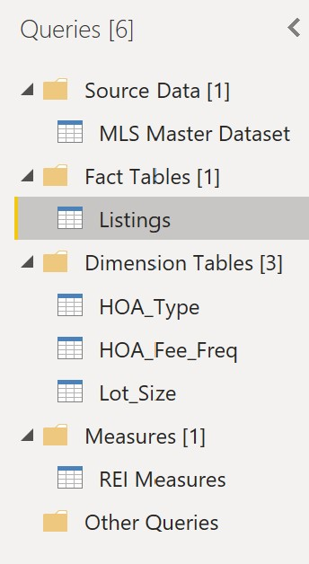

Scrub
Utilized Power Query to set data types, filter out unnecessary rows, and identify potential dimension tables based on cardinality
Notes:
Step 2 – Scrub the data:
In Power Query I updated the various data types and examined the distinct and unique data elements to determine cardinality which offered me some clues as to which columns should be broken out into their own dimension tables.

Slide 7

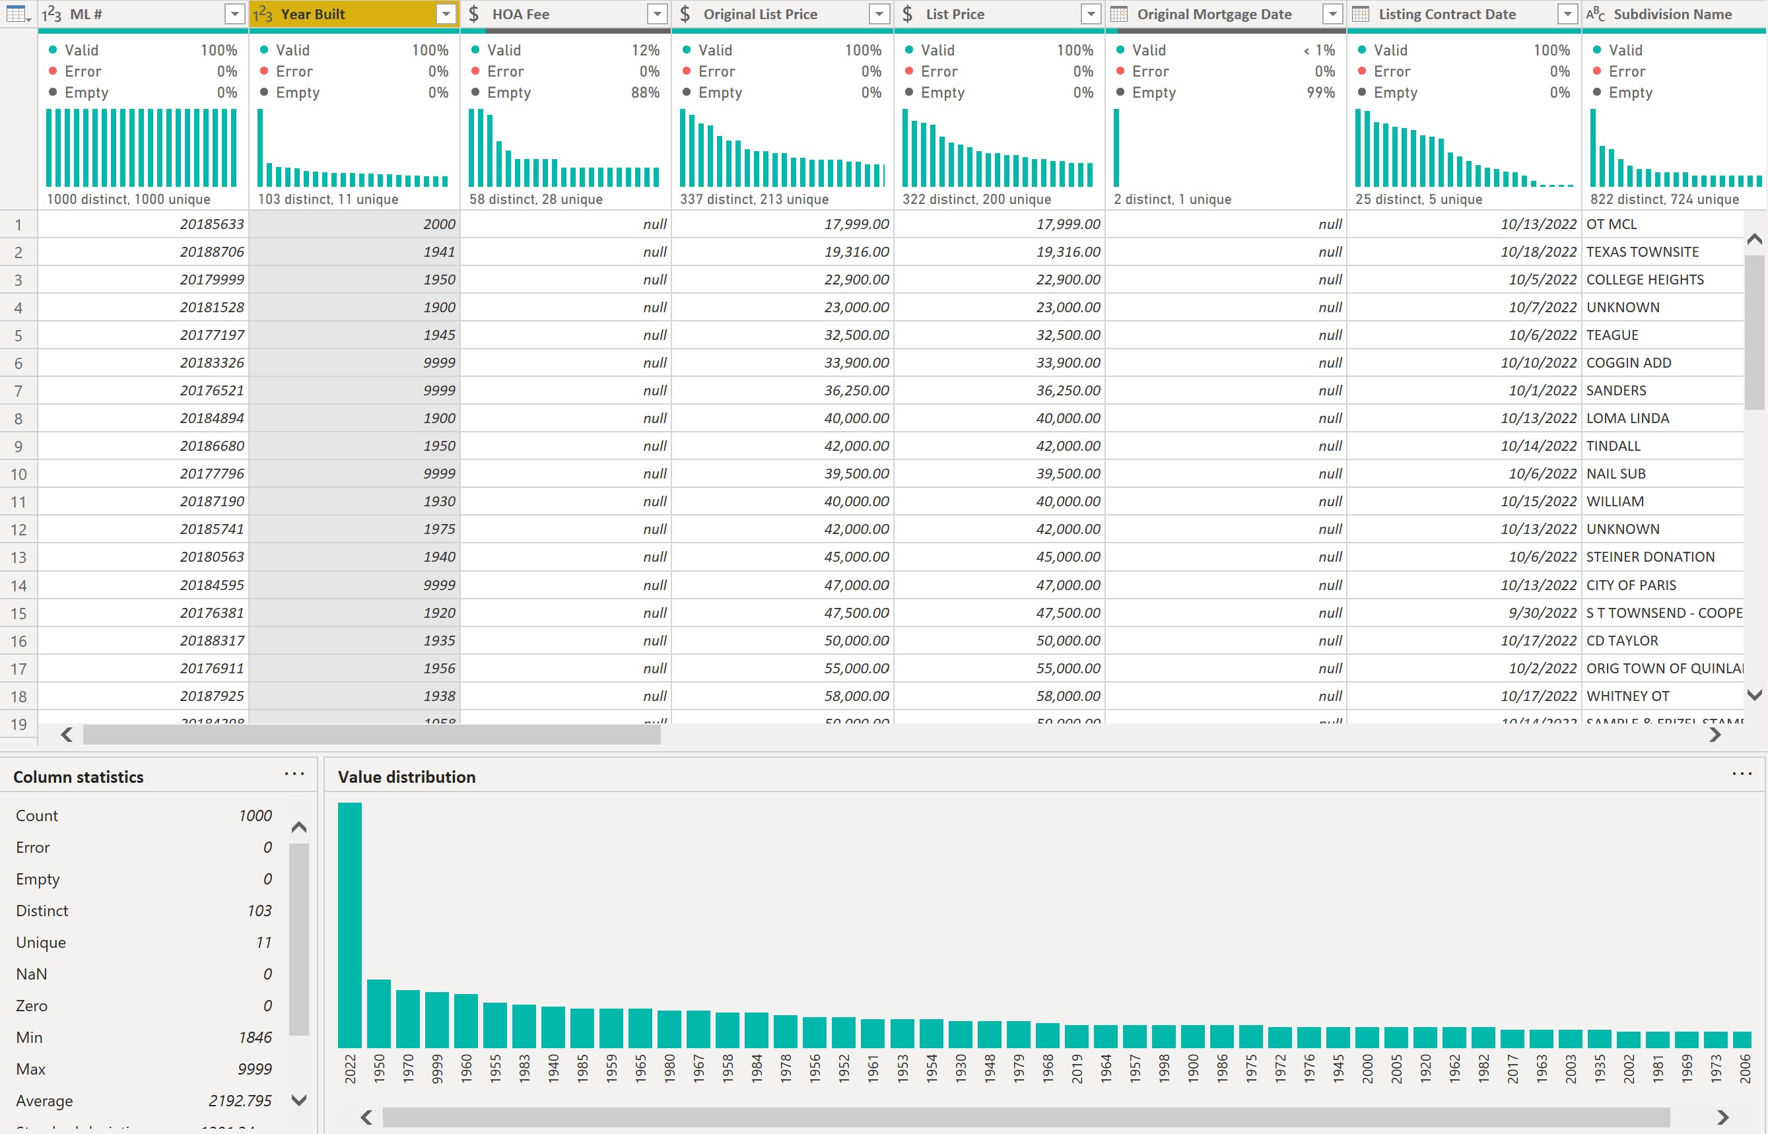
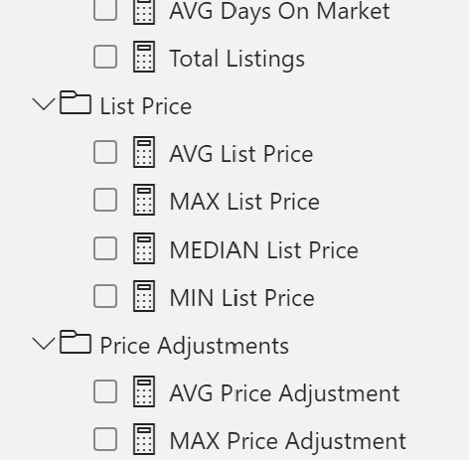
Explore
Utilized the Power Query editor’s data view options to explore and profile the raw data; then developed DAX columns and measures to further examine the dataset
Notes:
Step 3 – Explore the data:
I used Power Query to profile the data in terms of general distribution of data elements within each column before moving on to the main Power BI interface to begin creating initial calculated columns and measures using DAX. From there, I could experiment with a few visuals to ensure my DAX formulas were functioning properly.

Slide 8
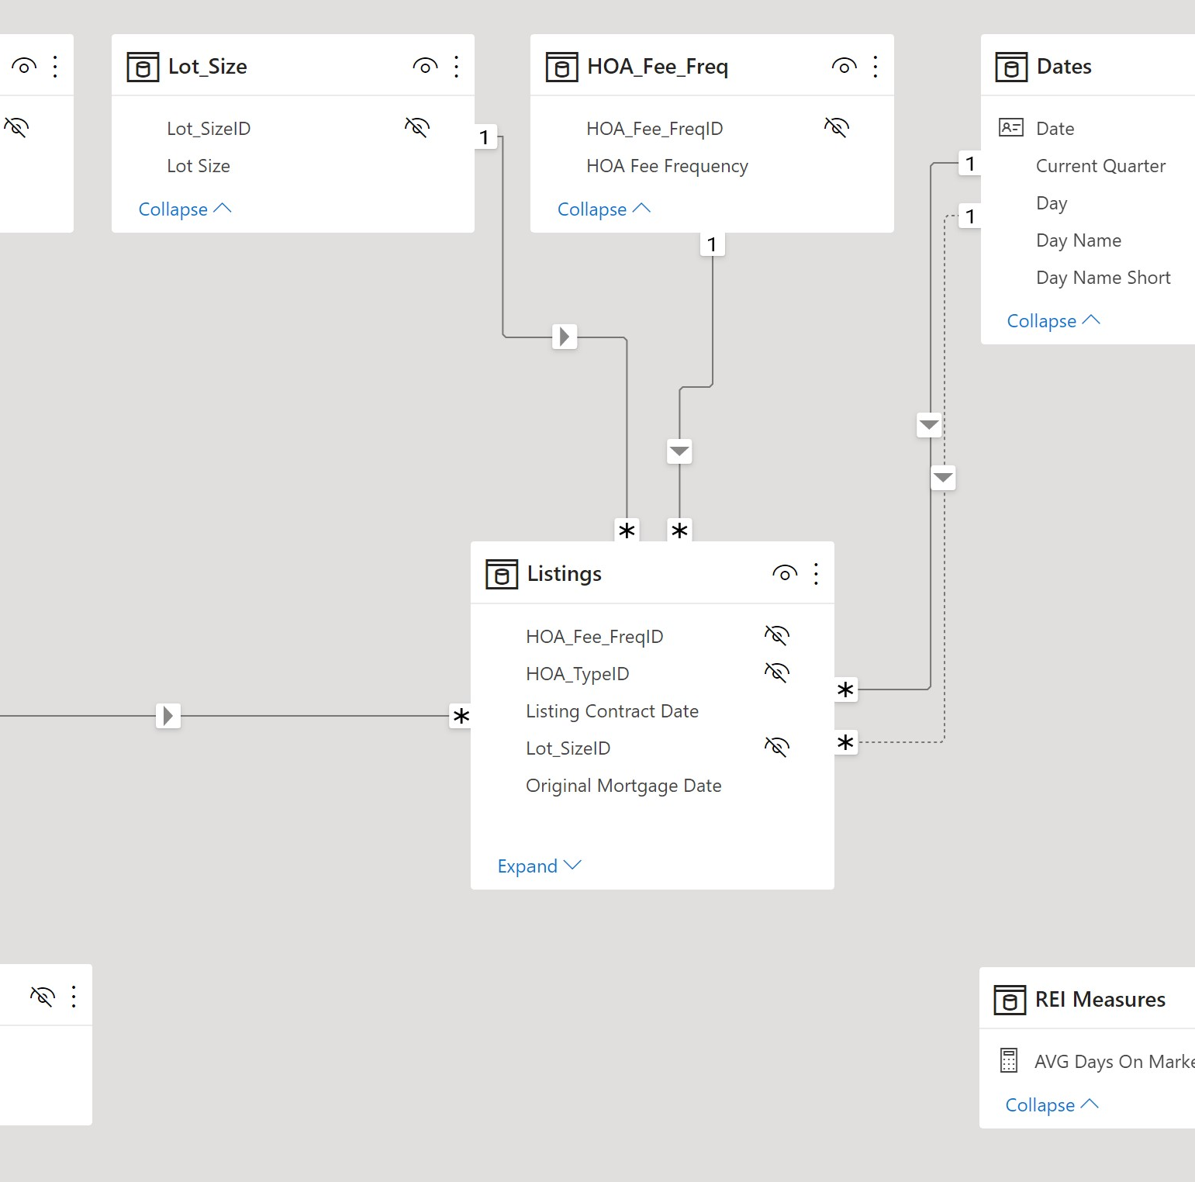

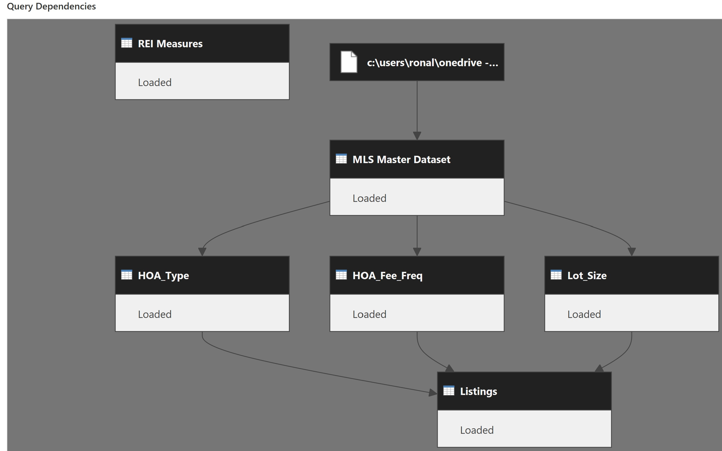
Model
Utilized Power Query to develop the data model and query dependencies; then used the Power BI model tab to establish appropriate relationships
Notes:
Step 4 – Model the data:
Assuming I performed the previous steps of the framework properly, I then moved on to the Model Tab within Power BI to establish, and in some cases remove relationships between my tables.
In Power BI, many of the relationships will be dynamically created if you maintain a consistent naming convention within your model. But this can sometimes cause a problem depending on the decisions you’ve made back in the Power Query Editor.
For example, I chose to “reference” the imported source table rather than “duplicate” that source table when it came to creating my fact and dimension tables—the advantage of this approach is that the actual raw data is ONLY loaded once… into the Power BI—your PBIX file…which could significantly decrease the size of the file if you’re working with large datasets.
The disadvantage, however, is that you must clean up the relationships that were dynamically created between the raw data source and your deliberate model.

Slide 9
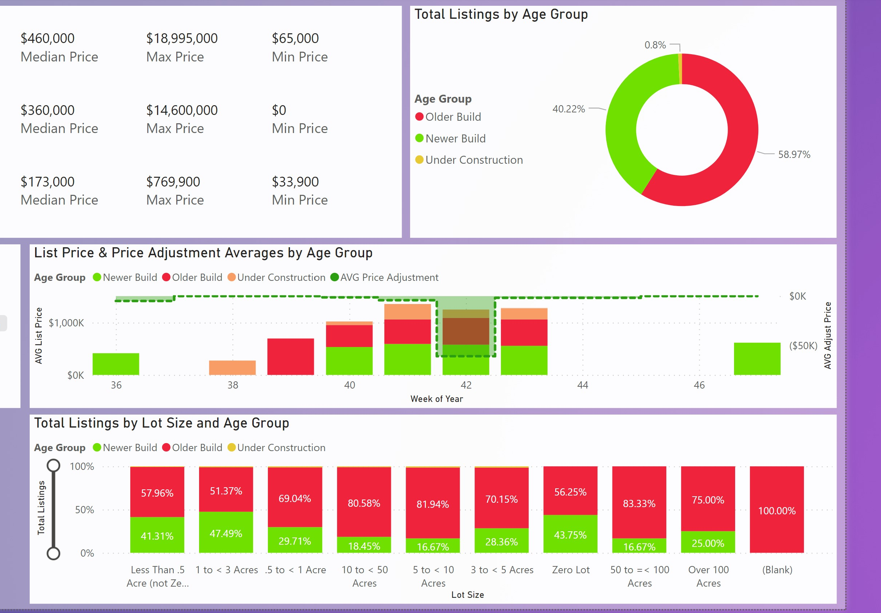
Interpret
Utilized DAX measures in combination with Power BI visualizations to establish a cogent story that can illustrate and potentially explain the insights within the dataset
Notes:
The last step in the framework is – Interpret the data:
But I should mention here that the framework is iterative so that you can go back to a previous step when you’ve gained some insights that motivate you to make changes to your model, or if you receive an expanded dataset.
I put together a two-page report which I’ve embedded in this presentation on the next slide…
It might take a bit to load since I’ll be pulling the report directly from the cloud in the Power BI Service so please be patient with me as we transition to the next slide…

Slide 10
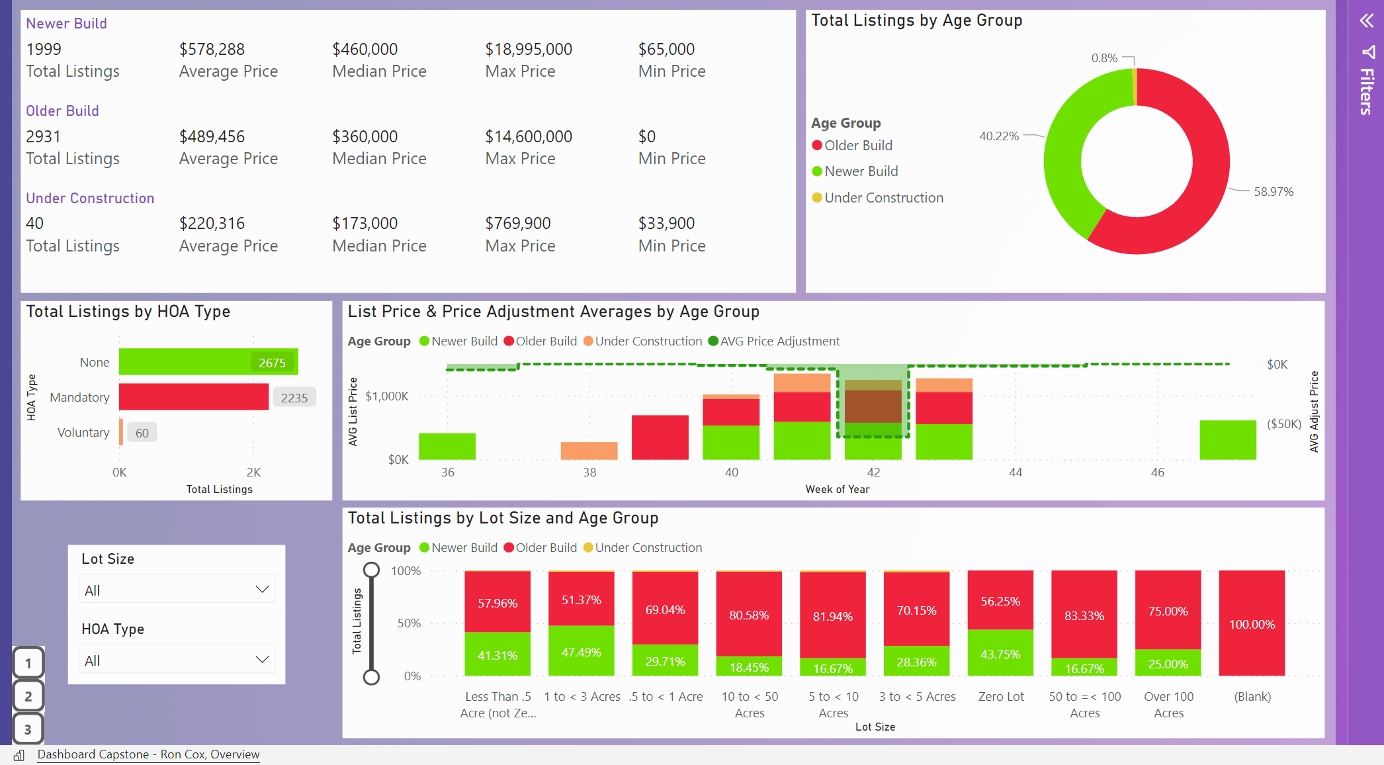
Notes:
This page of the Power BI report includes most of the available the data, but I chose to filter out one of the Lot Size options because my personal investment strategy does not include condominiums nor townhomes.

Slide 11

Q&A

